Slide 1
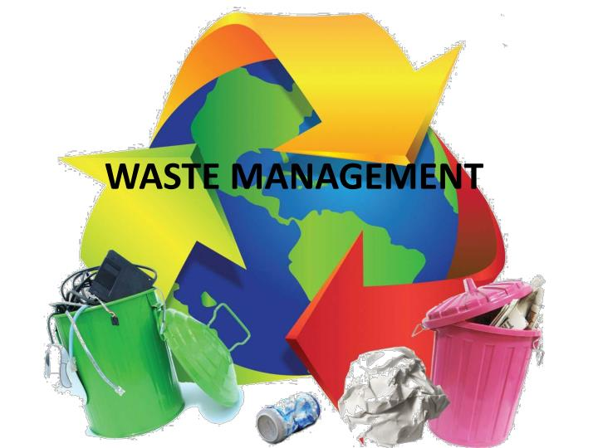
Azure IoT Waste Management Solution
Software Stack

Slide 2
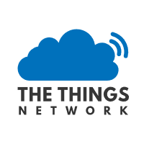



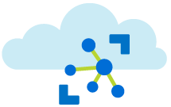
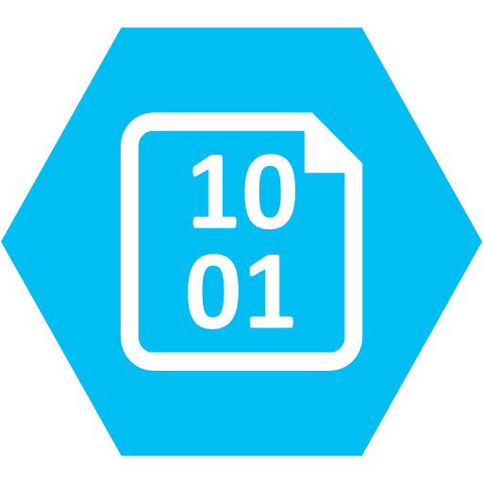



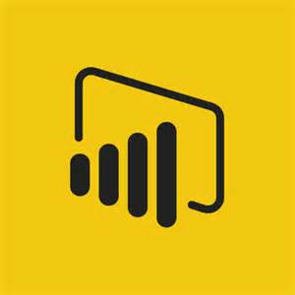

Azure Function Based Waste Manage System
Things Network Bridge HTTP Trigger
Telemetry Queue
Alert Queue
Azure Event Hubs Trigger
Archive Queue
Archive Blobs
Azure IoT Hub
Latest Weather 15 Min Timer
Weather Table
Azure Analytics
Sensor State Table
Power BI Embedded

Slide 3
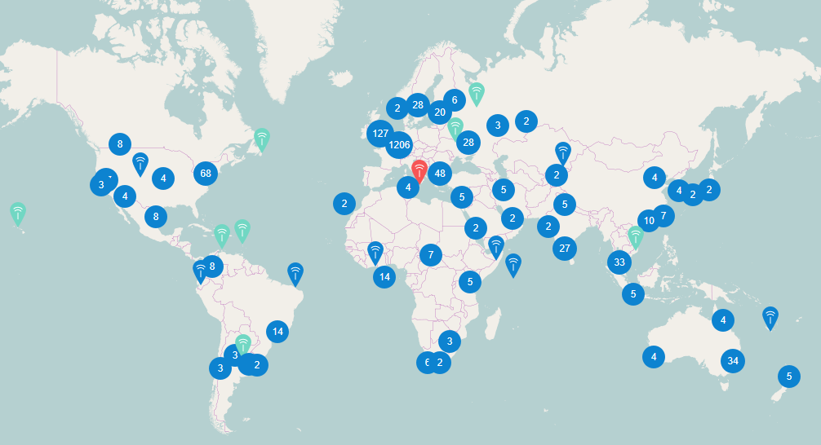
The Things Network and LoraWAN (https://www.thethingsnetwork.org/map)

Slide 5
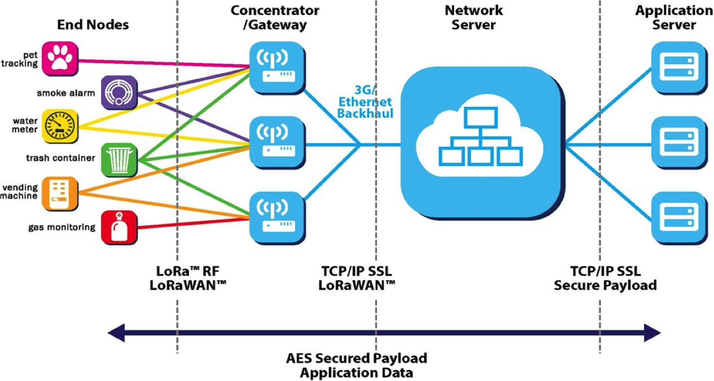
LoraWAN

Slide 6
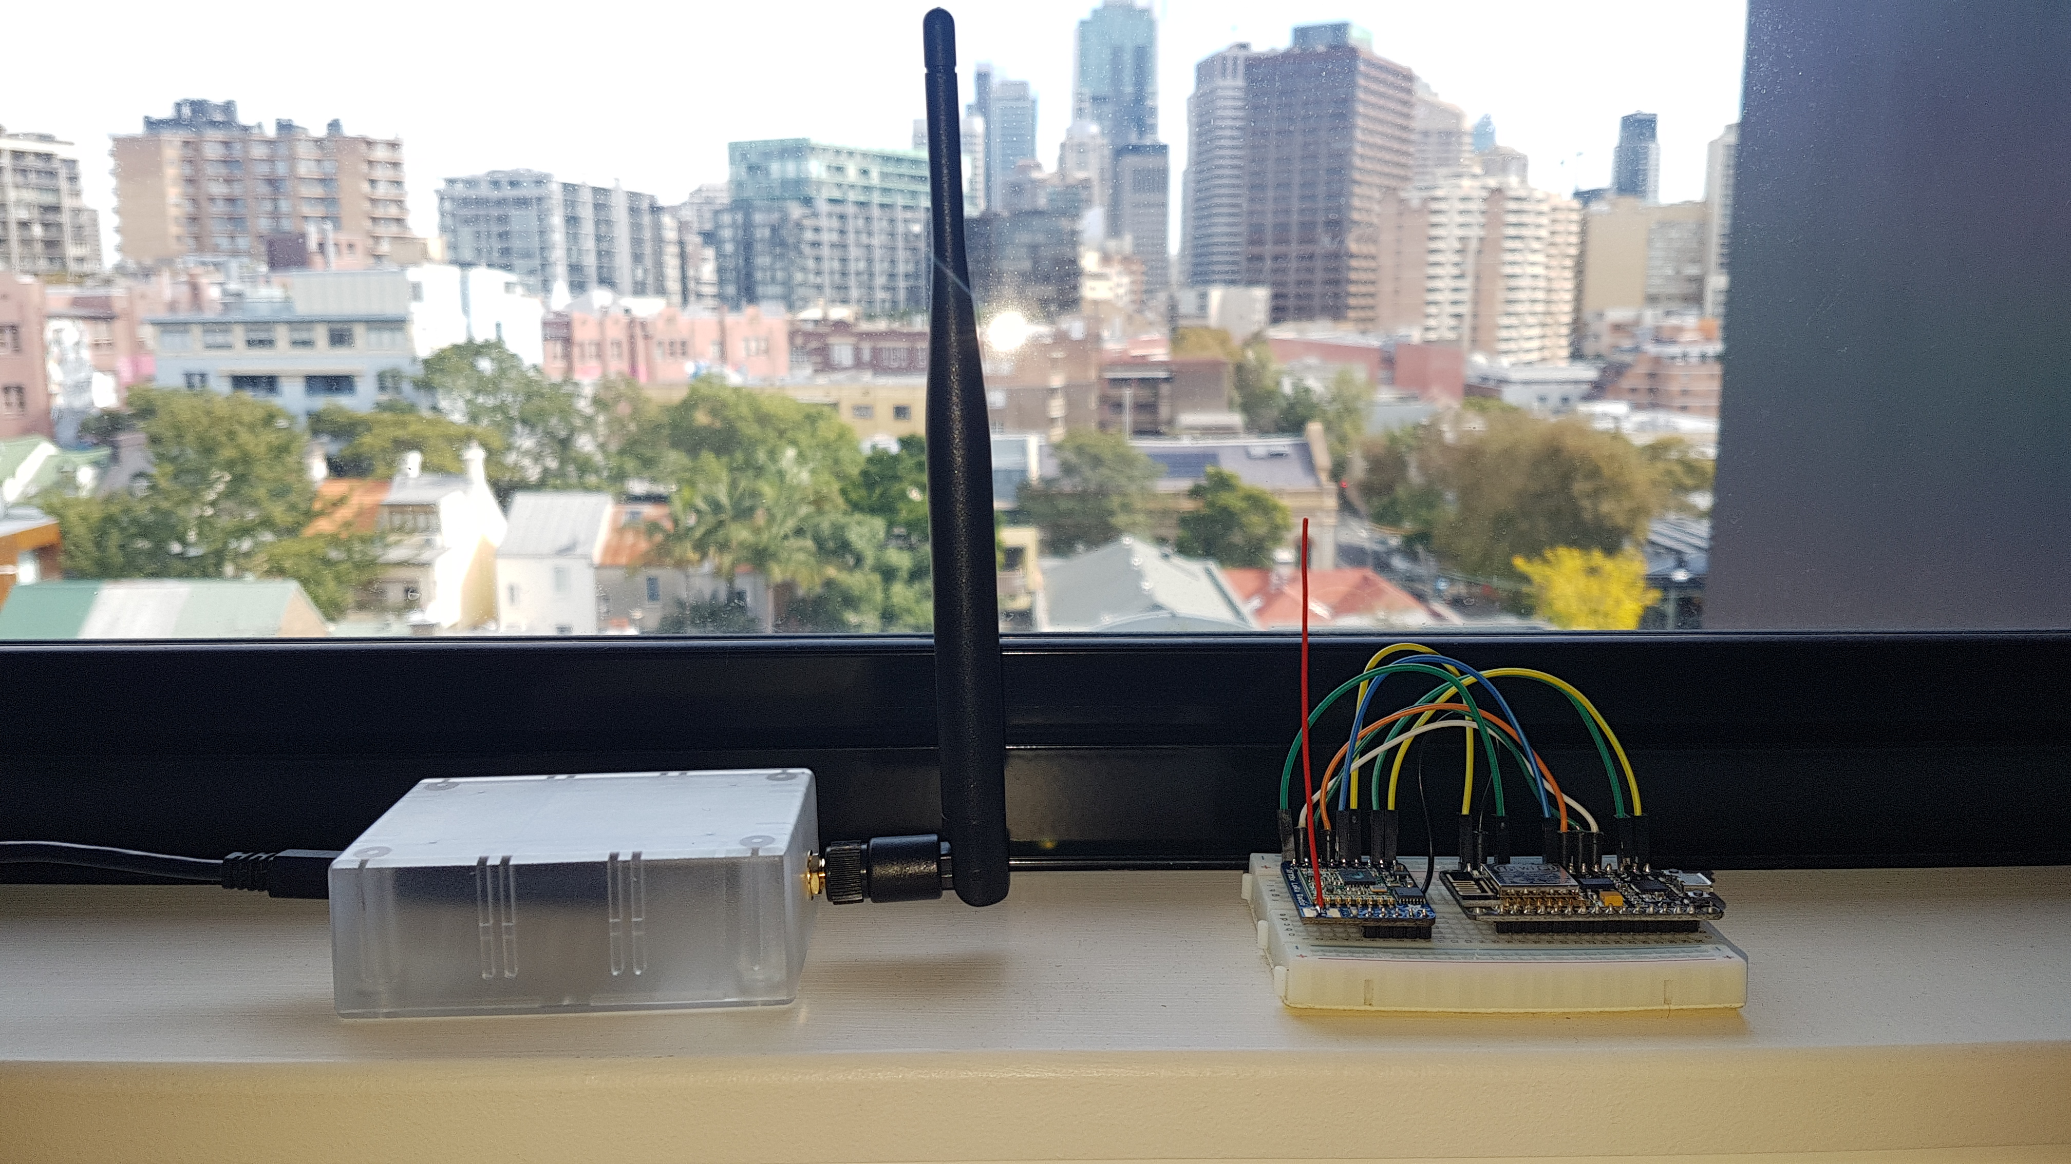
LoraWAN Devices Approx 2km fromTTN GW

Slide 7
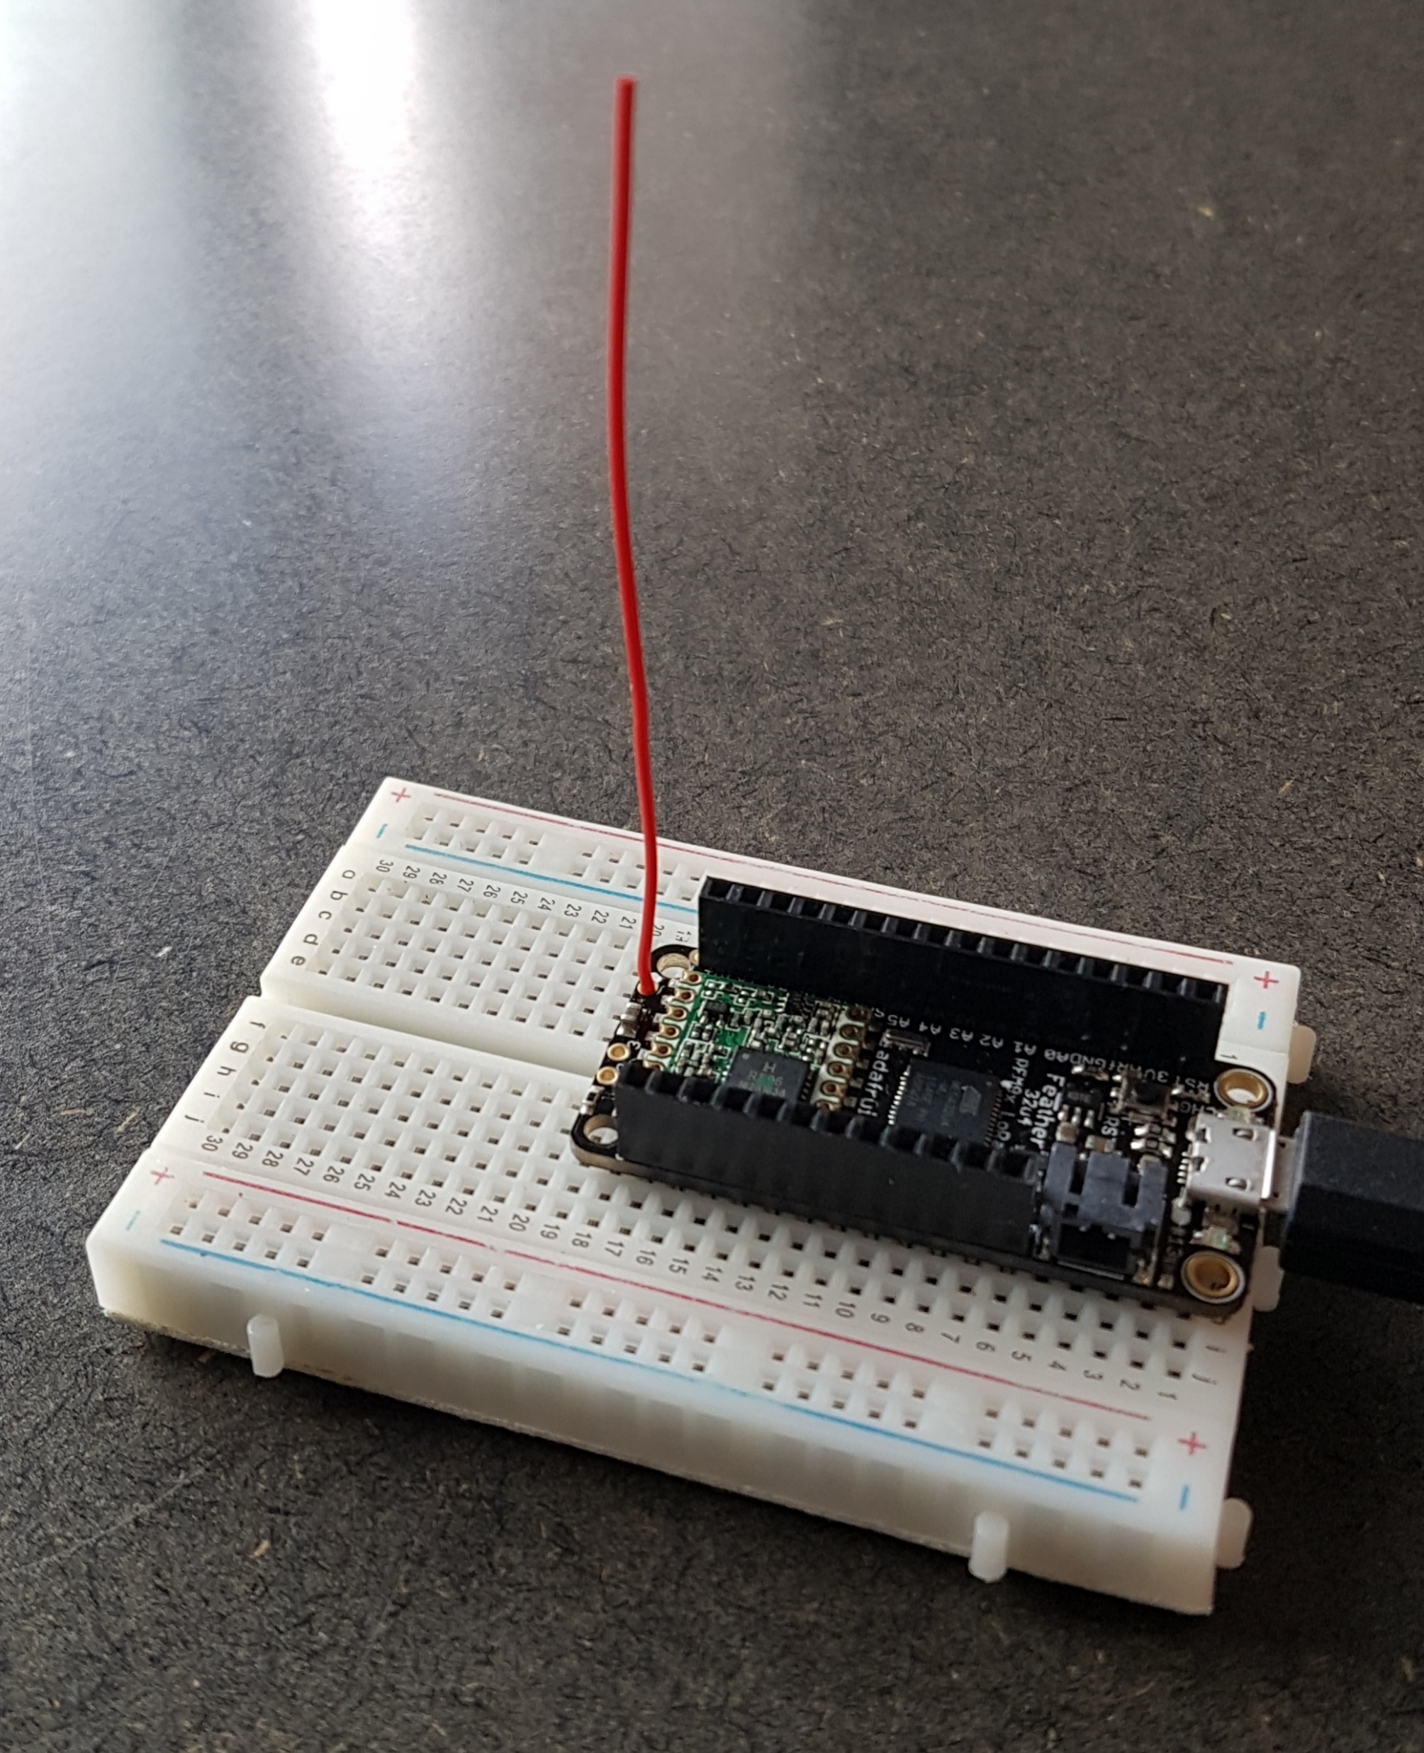
Resources
Adafruit Feather 32u4 RFM95W LoRa Radio - 900MHz
LoraWAN for Australia Frequencies
https://github.com/gloveboxes/arduino-lmic

Slide 8
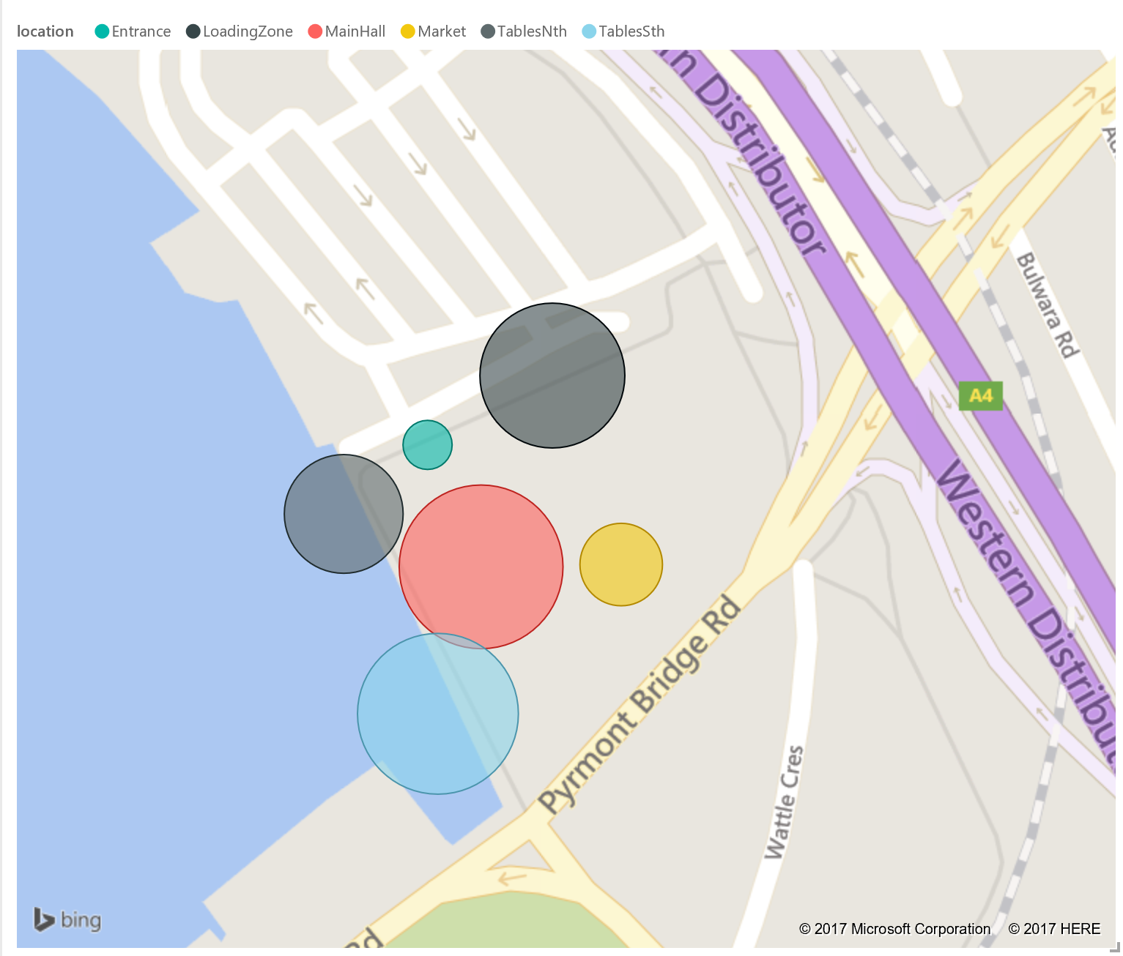
On Demand Reporting

Slide 9
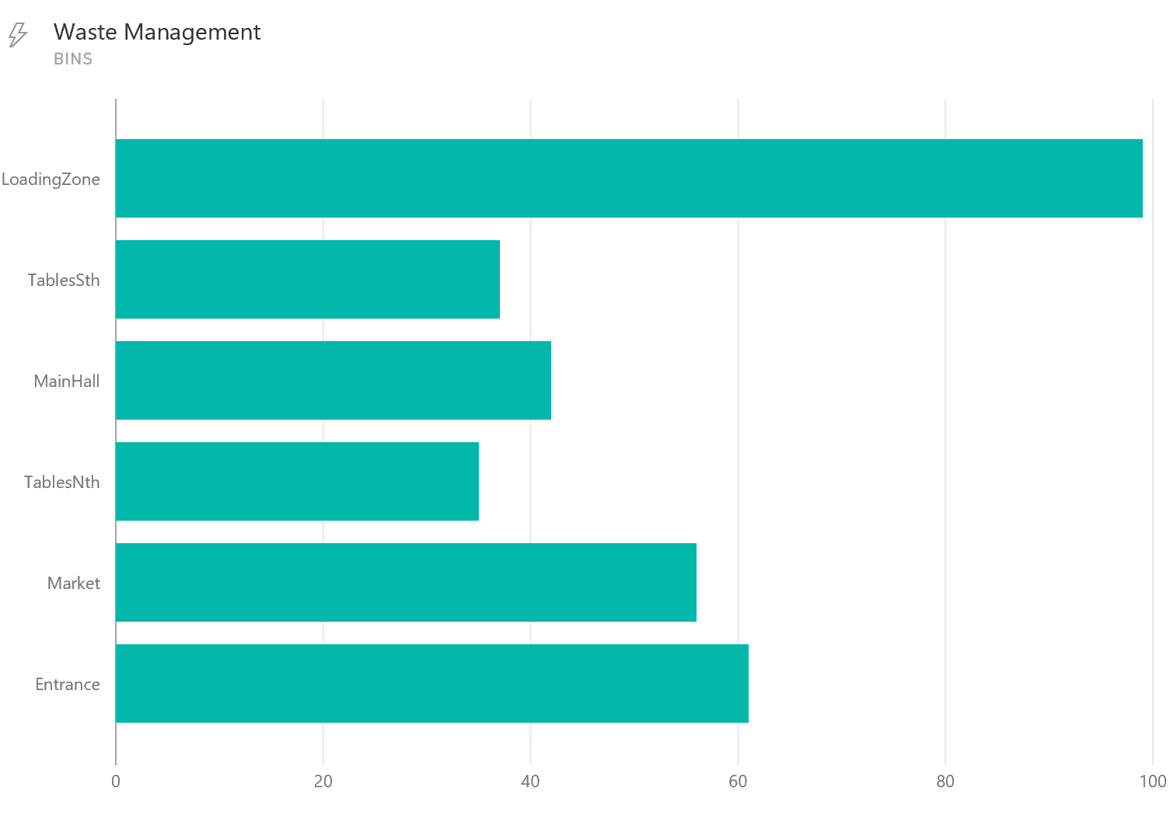
Real Time Reporting

Slide 10
Demo
Waste Bin Data Simulator
The Things Network Bridge
Power BI
Alerts: SMS (Twillio Cost)

